Slide 1

HR DATA INTELLIGENCE TOOL

Slide 2

HOW CAN I TRACK THEM?

Slide 3
Problem Statement
HR wants to know these things:
Data Consolidation: Combine April, May, and March data for insights.
Working Preferences: Analyze work from home vs. office trends, especially on Fridays and Saturdays.
Attendance Analysis: Understand monthly and weekly employee attendance patterns.

Slide 4
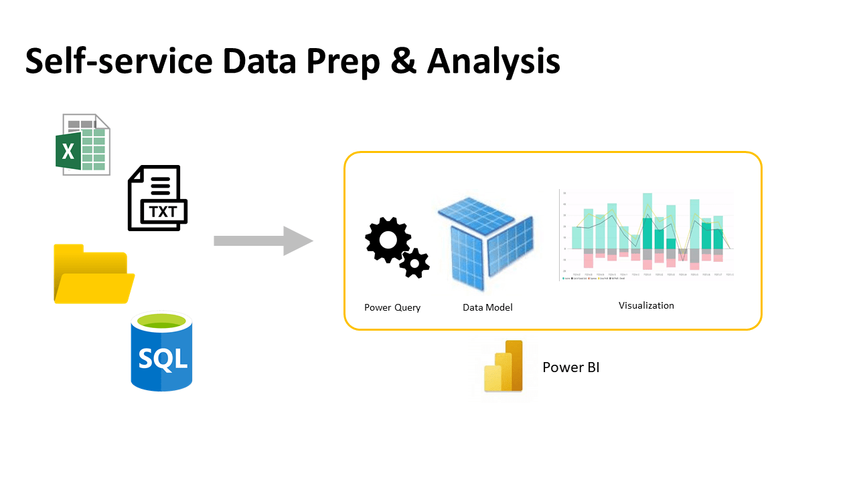
PROPOSED SOLUTION
DATASET

Slide 5
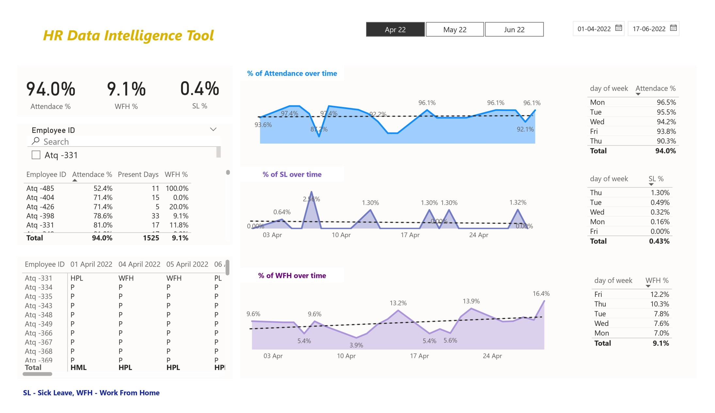
RESULTS

Slide 6
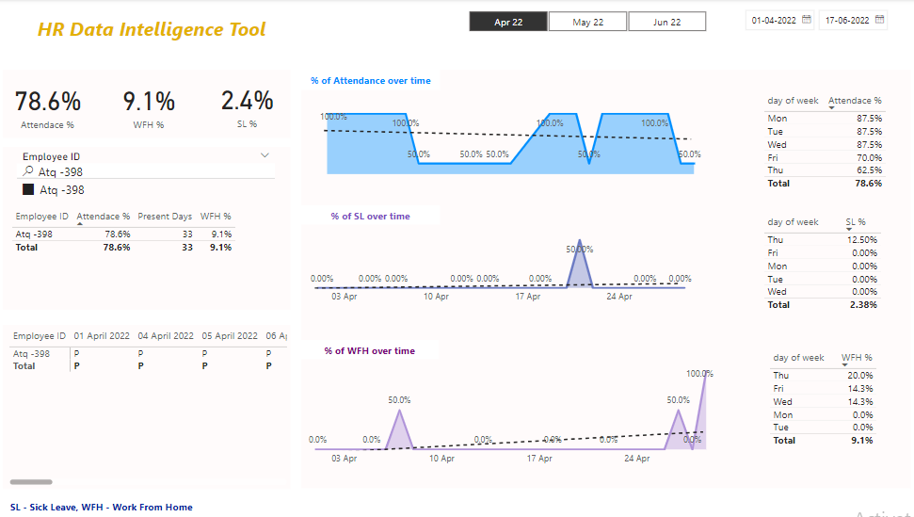
Checking Details with respect to particular employee

Slide 7
INSIGHTS FROM THE DASH BOARD
WORK FROM HOME ON FRIDAYS – COMPANY CAN PREFFER SOME SCHEDULE MAINTENCE TASKS SUCH AS ELECTRICITY WORK ETC RATHER THAN WEEKENDS
MAKING COMPANY MEETUPS – WE CAN SEE THROUGH THE DASHBOARD & ARRANGE WHEN MOST PEOPLE ARE PRESENT THAT PARTICULAR DAY
HYBRID WORK FROM HOME MODELS – IF COMPANY SIZE IS 100, WE HAVE SPACE FOR ONLY 80 PEOPLE , WE CAN MAKE EMPOLYEES TO COME ON ALTERNATE DAYS, SO THIS RESULTS IN RESOURCE UTILIZATION

Slide 8
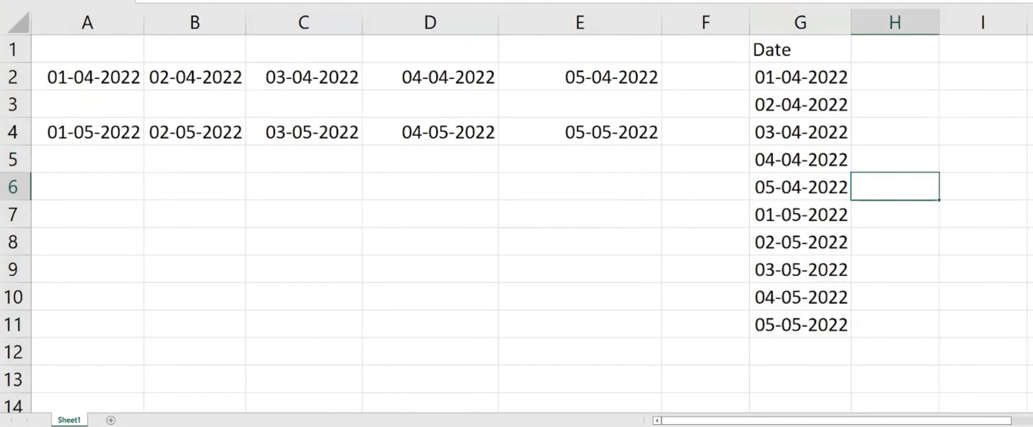
Challenges
Unpivoting Columns
Challenge: Converting multiple date columns into a single column for better analysis.
Solution: Used unpivoting techniques in Power Query to restructure the data.

Slide 9
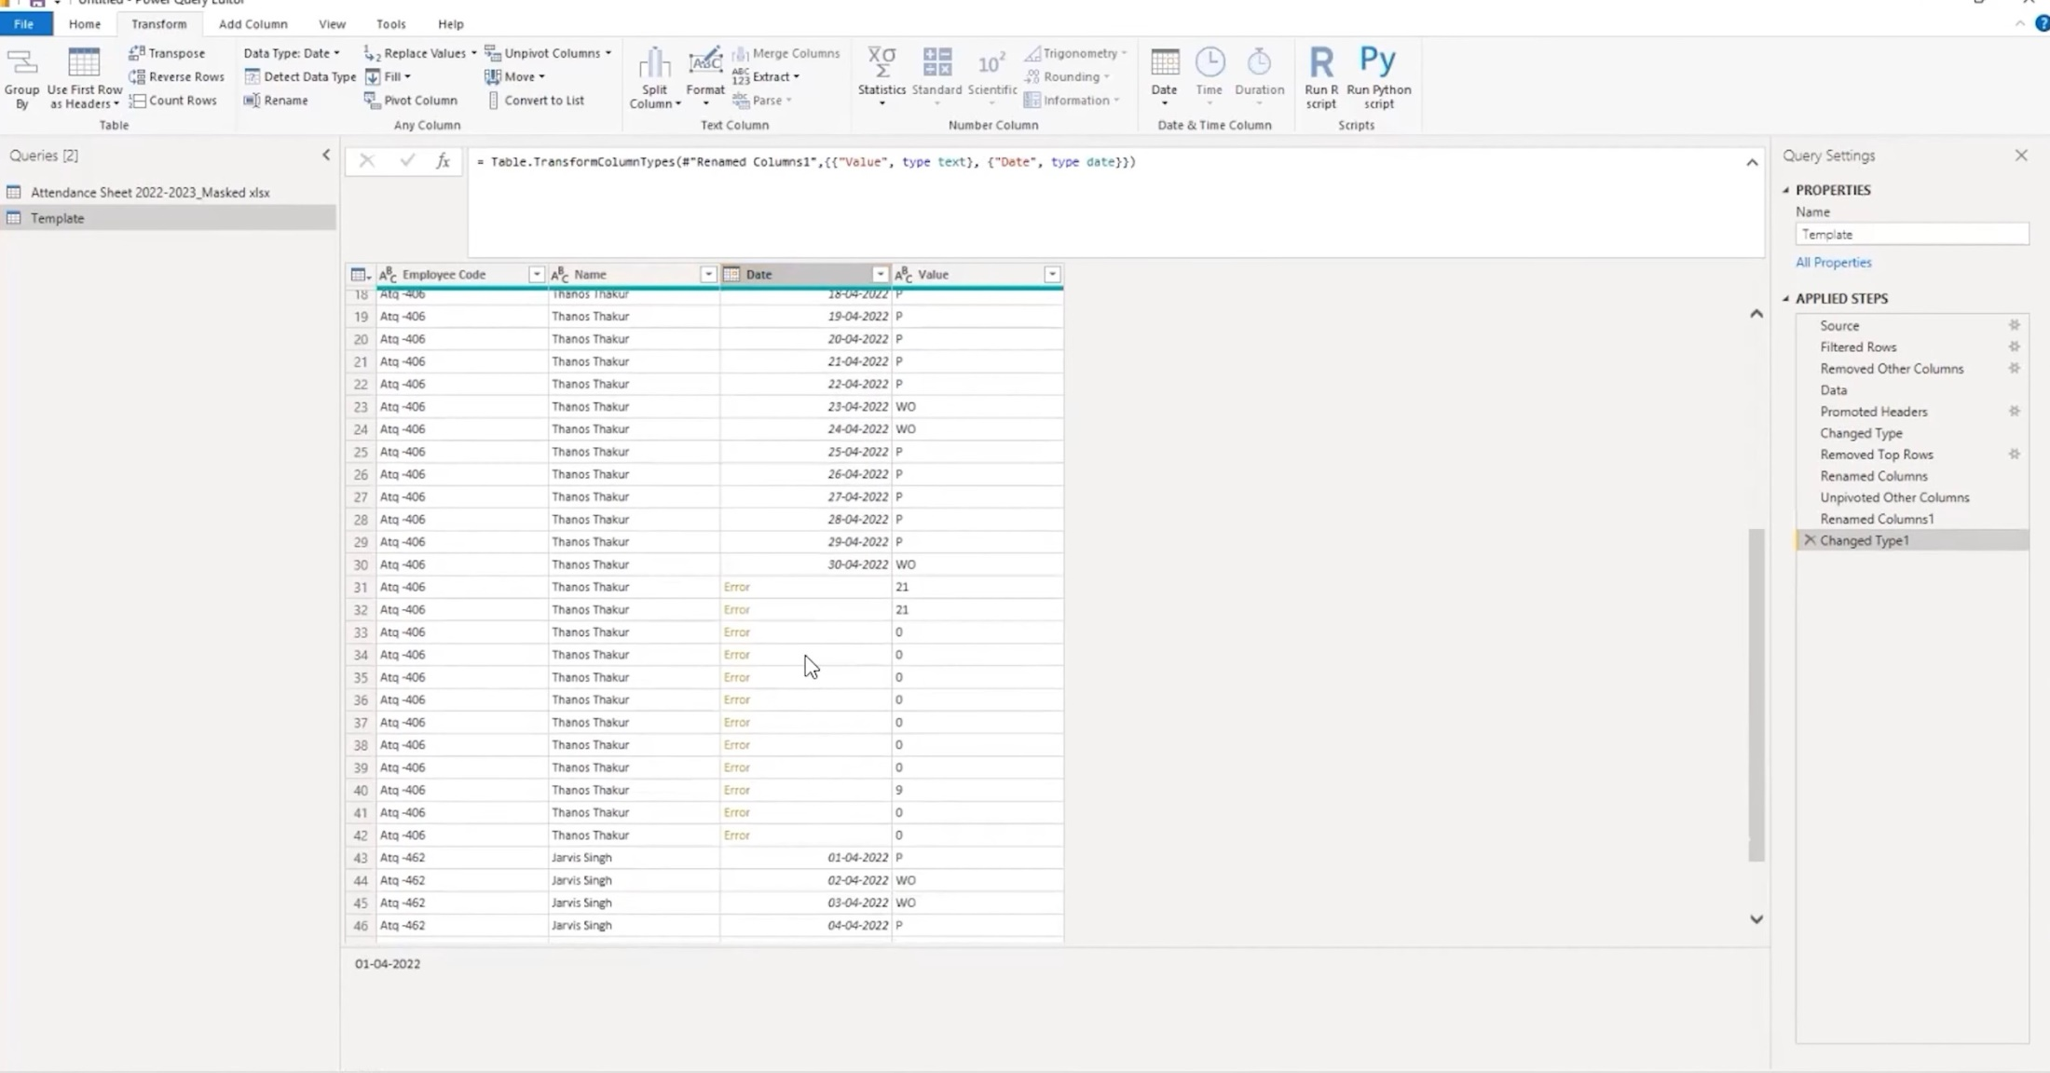
Handling Unwanted Data
Challenge: Too many unwanted data elements, such as unnecessary attendance keys and erroneous date strings.
Solution: Removed unwanted data while building dashboards and changed the string type to date type to eliminate errors.

Slide 10
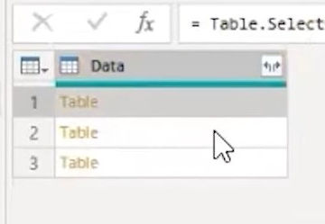
Dynamic Data Transformation
Challenge: Creating a process that adapts to new data automatically.
Solution: Developed a function in Power Query to apply transformations dynamically to any new data.

Slide 11
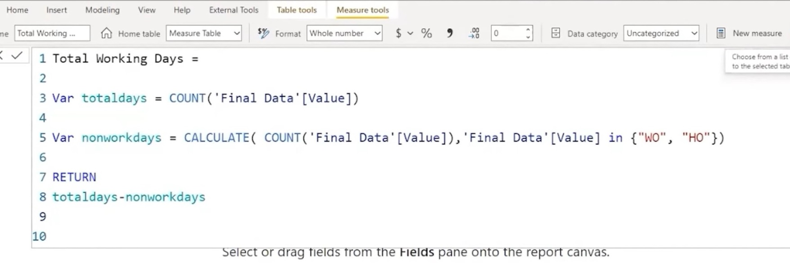
Creating Meaningful Metrics
Challenge: Designing metrics that provide valuable insights for HR decision-making.
Solution: Used DAX in Power BI to create quantitative assessments and separate data tables for clear calculations.

Slide 12
Effective Dashboard Design
Challenge: Presenting data in a user-friendly and informative manner.
Solution: Focused on left-to-right layout and highlighting key information in the dashboard.
Github link =

